Slide 1
“Movie Ticket Booking System”
Presented By-
Group Number:7
Shaik Abdul Ashfaq Jani – AP22110011160
Rohan Praneeth. K – AP22110011137
Nandita – AP22110011157
T. Sai Sruthi – AP22110011176

Slide 2
Agenda
Aim/Objective
Abstract
Introduction
Modules
Algorithm
End user

Slide 3
Aim/Objective
The aim of our ticket booking system project is to provide an efficient and convenient platform for users to purchase tickets for movies. The main objectives of such a system are typically to:
1.Streamline the ticket purchasing process, allowing users to quickly and easily find and book the tickets they need.
2.Provide accurate real-time information about available tickets and events.
3.Ensure secure payment processing and data management.
4.Offer customizable options for ticket type, seat selection, and pricing.
5.Provide a user-friendly interface that is accessible and easy to navigate.
6.Provide information about booked tickets.

Slide 4
Abstract
A movie ticket booking system is a project where the user can utilize the application in a way useful to him/her. The application contains information regarding the theatres and seats available. The user can either create an account and log in or already login into a created account. Using this application, the user can book the available theatre followed by booking seats. At last, the user can view the booking of his ticket.

Slide 5
Introduction
This code is a basic implementation of a movie ticket booking system in the C programming language. The code contains various functions, each of which performs a specific task. The main function of the code, "main", acts as a starting point for the program and presents the user with two options: either to create a new account or to log in as an existing user. If the user selects the first option, then the "new log" function is called, where the user is prompted to enter their name, email ID, username, and password. This information is then stored in a text file with the name of the user as the file name. If the user selects the second option, then the "old log" function is called, where the user is asked to enter their username and password, which are then compared with the information stored in the user's text file. If the entered details match the stored information, the user is granted access to the system and can either book a ticket or view their existing tickets. The "book tickets" function allows the user to book a ticket, while the "view tickets" function displays the user's ticket information. Overall, the code provides a basic movie ticket booking system that can be used as a starting point for a larger project.

Slide 6
Algorithm
Initialize variables and arrays to store the data of theatre and user information.
Start the program with a welcome message and options for new users and existing users.
If the user selects "new user", take the user's name, email, username, and password as input and store it in a structure "user".
Create a new file with the name as the username entered by the user and store the username and password in it.
Call the function "accountcreated" to inform the user that the account has been created successfully.
If the user selects "existing user", ask for the username and password.
Read the file with the name as the username entered and check if the entered password matches with the stored password.
If the password matches, provide the user with options to buy tickets or view tickets.
If the user selects to buy tickets, call the function "bookticket" to book the tickets.
If the user selects to view tickets, call the function "viewticket" to view the booked tickets.
If the password doesn't match, inform the user that the password is wrong.
End the program.

Slide 7
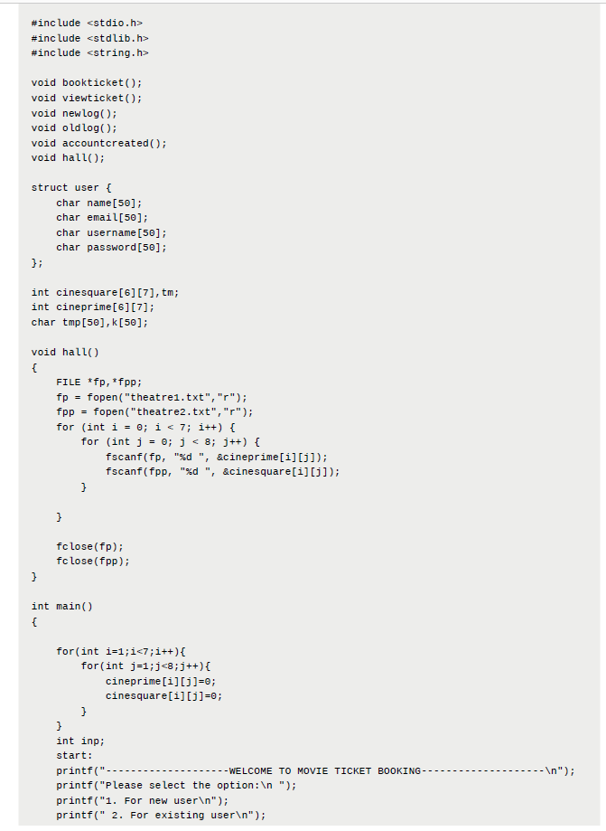
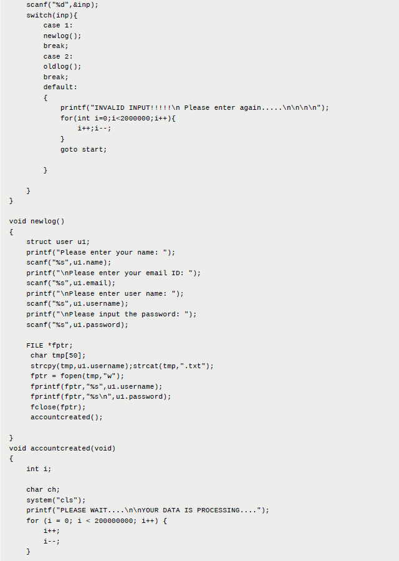
Source code:

Slide 8
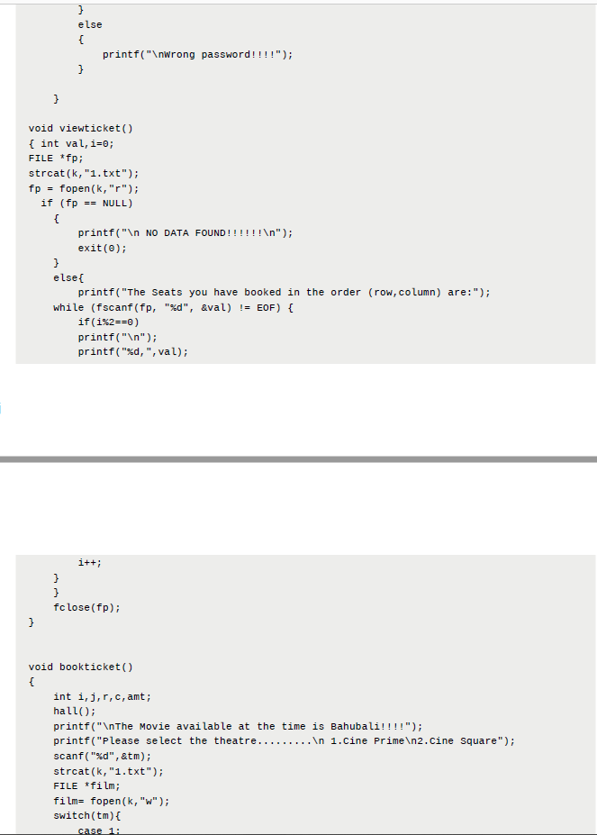
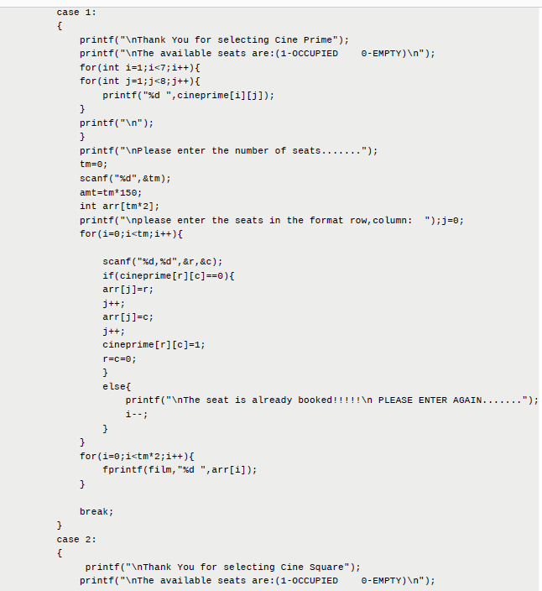
Source code:

Slide 9
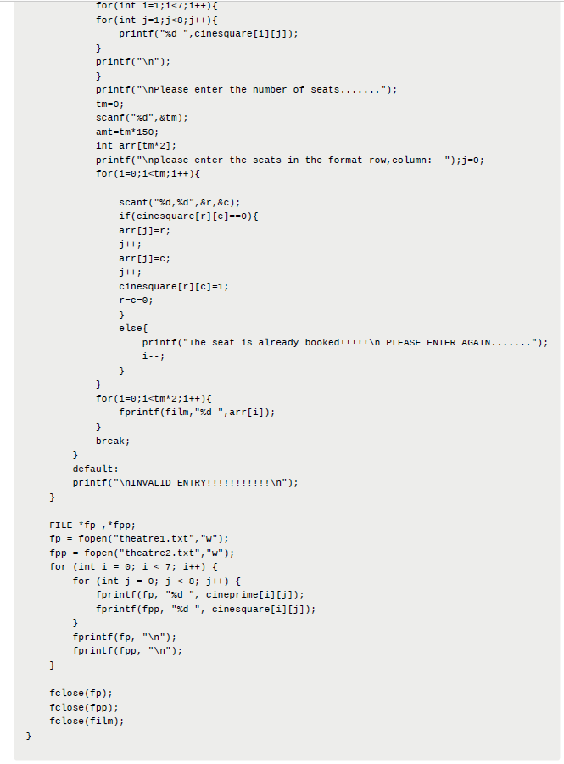
Source code:

Slide 10
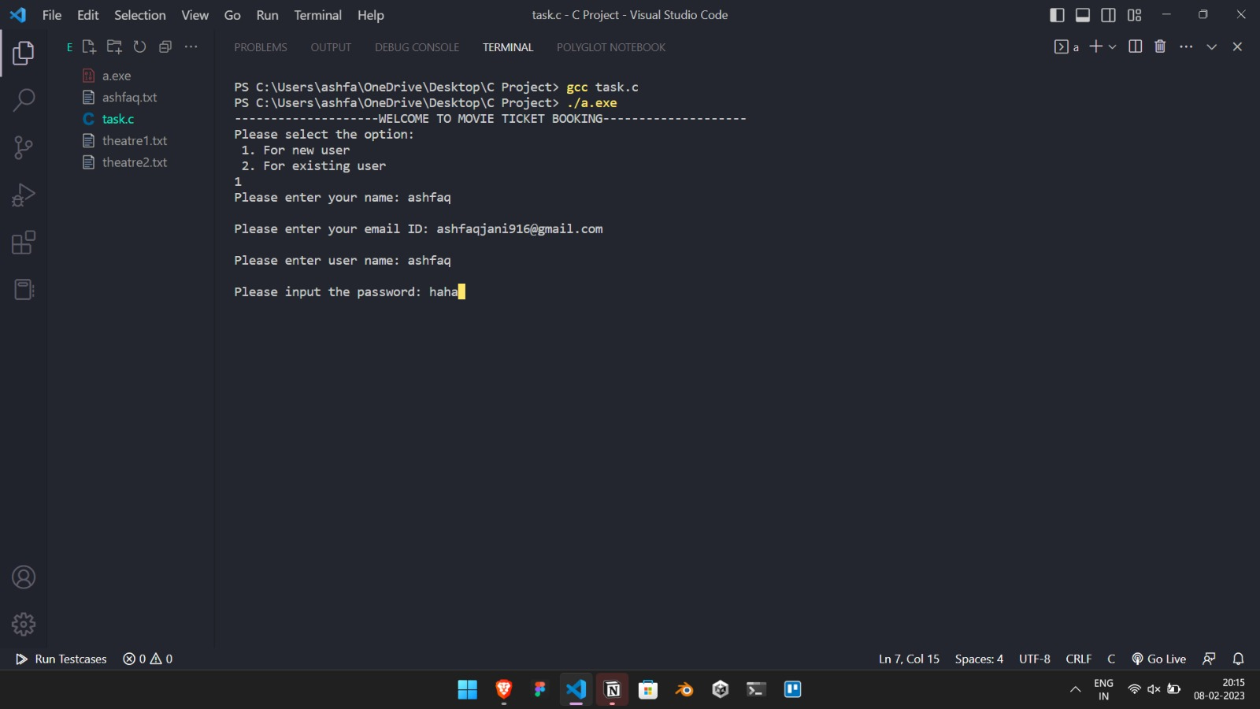
End User of Project

Slide 11
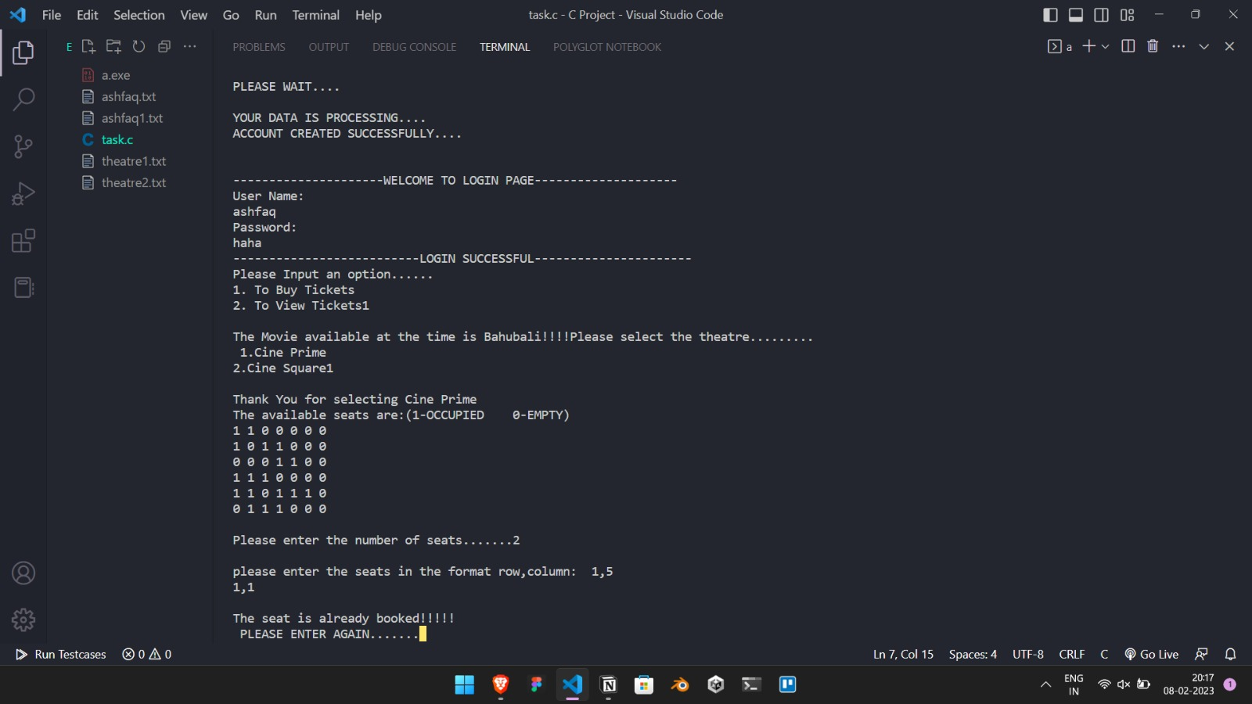
End User of Project

Slide 12
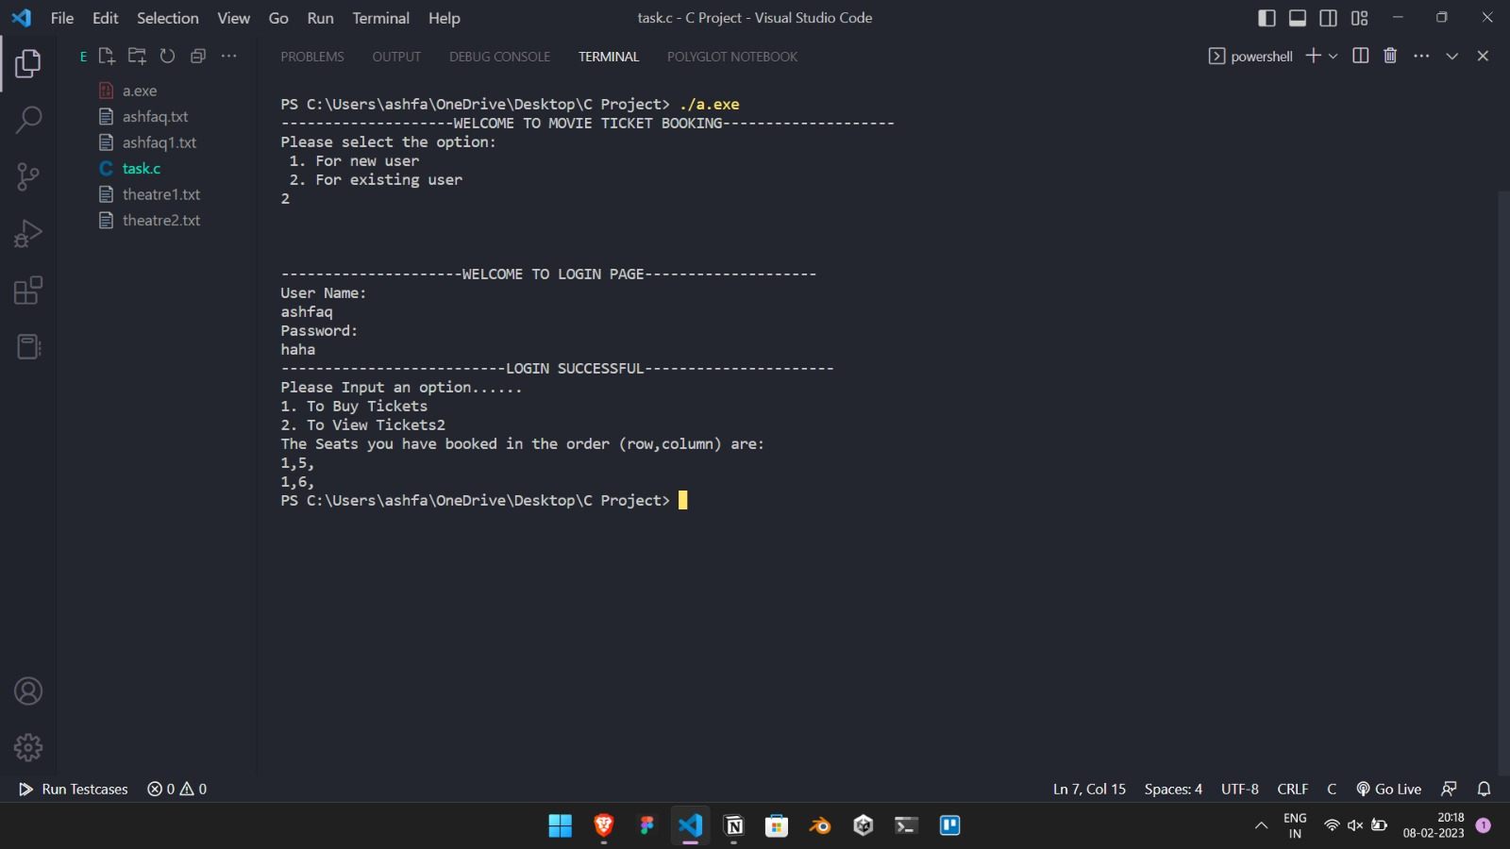
End User of Project

Slide 13
Thank You

